Slide 1
Lagrange and Newton’s
Polynomial Interpolation
Josh Miranda
CSC 301
May 17, 2021

Slide 2
Overview
What is Lagrange Polynomial Interpolation?
Lagrange Example
What is Newton’s Polynomial Interpolation?
Newton Example
Gold Price Dataset
Comparison

Slide 3
What is Lagrange Polynomial Interpolation?

Slide 4


What is Lagrange Polynomial Interpolation?
Given n + 1 distinct numbers and a function f exist within these values, we can say that a unique polynomial P(x) of degree at most n exist within
Then this polynomial is given by

Slide 5
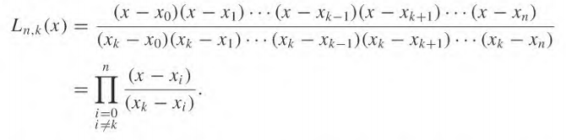
For each k = 0, 1 … n

Slide 6
Lagrange Example

Slide 7
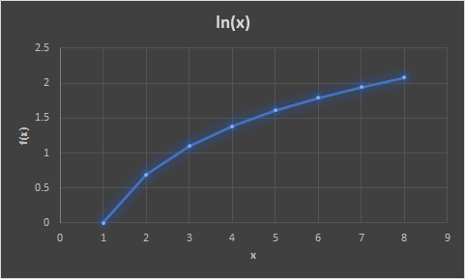
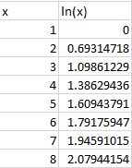
Using the Lagrange method, predict the values of the natural log function

Slide 8
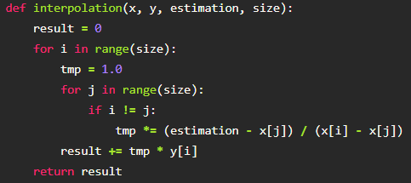
Code for Lagrange
Data set of ln(x)

Slide 9
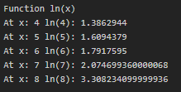
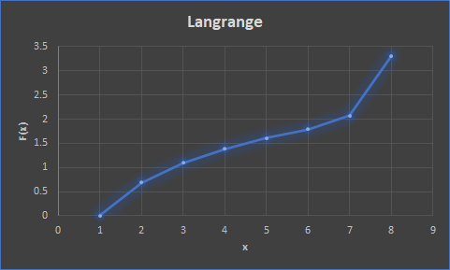
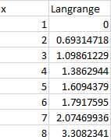
Output

Slide 10

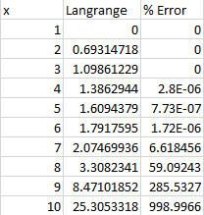
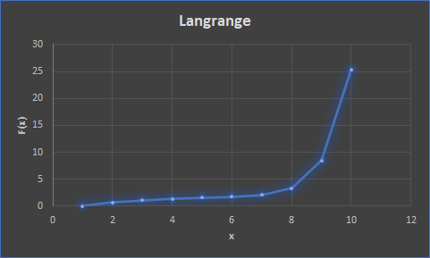

Slide 11
What is Newton’s Polynomial Interpolation?

Slide 12

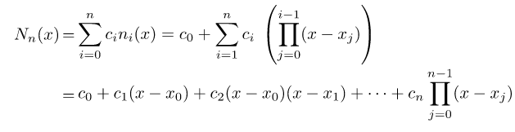
What is Newton’s Polynomial Interpolation?
Basis polynomial of Newton Interpolation
Construction of Newton polynomial interpolation

Slide 13
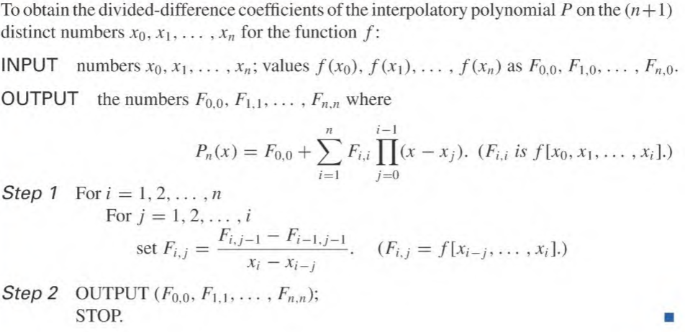
Pseudo Code

Slide 14
Newton’s Example

Slide 15
Using the Newton's Interpolation method, predict the values of the natural log function

Slide 16
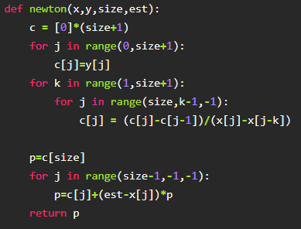
Code for Newton’s Interpolation
Data set of ln(x)

Slide 17
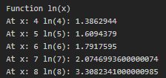
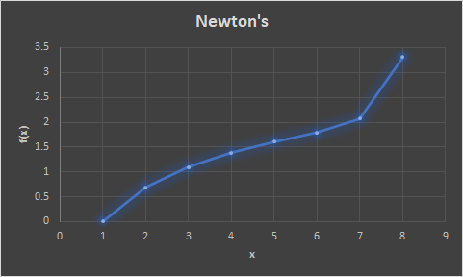
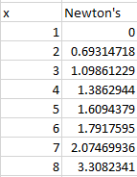
Output

Slide 18

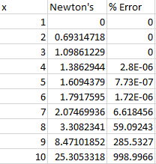
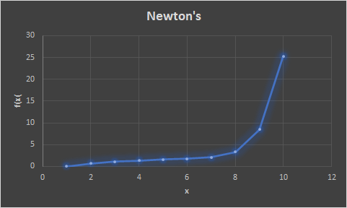

Slide 19
What does this
tell us?
Similar outputs
Good for approximating points that we start with
Bad for finding big jumps

Slide 20
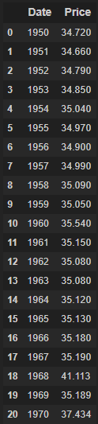
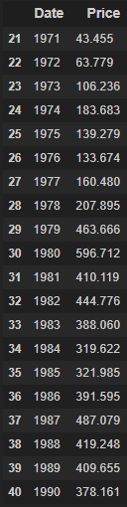
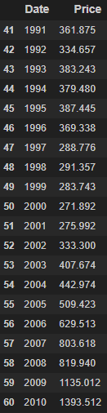
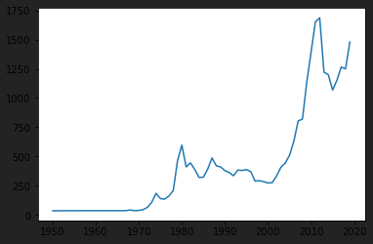

Dataset
Historical Annual Gold Price

Slide 21


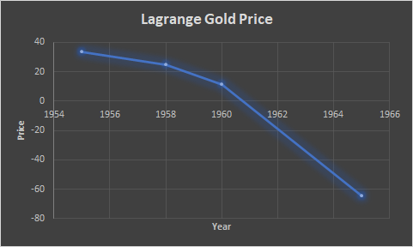
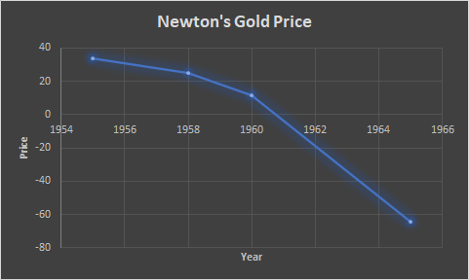
Lagrange vs Newton

Slide 22
Conclusion
Results for Lagrange and Newton’s is the same
Better results when approximating points one or two after given data
Difference is the computational approach to these methods

